Slide 1
Literary Terms
Ms. Bailey

Slide 2
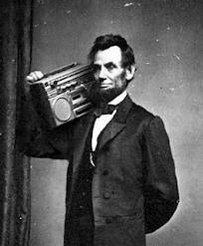
Anachronisms
An anachronism is an object or idea that is out of its time element.
Example:
Recliner, matches, electricity, etc.

Slide 3
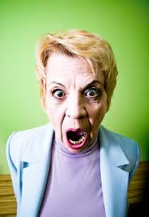
Imagery
The “word pictures” that writers create to evoke an emotional response
Example:
It isn't merely the mother of all colds she has; it's the mother-in-law.

Slide 4
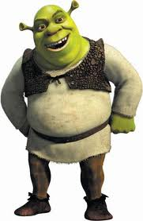
Character
A person portrayed in a literary work
Main Character (Shrek)– central to the story; fully developed
Minor Character (Donkey) – has few personality traits; helps move the story
Round Characters (Fiona)– show varied and sometimes contradictory traits
Flat Characters (Soldiers) – only show one personality trait
Dynamic Characters (Shrek)– grow and change throughout the story
Static Characters (Pinocchio)– stay the same

Slide 5
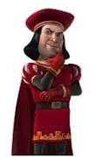
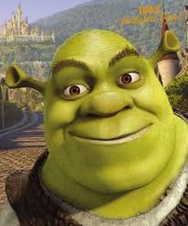
Character
Protagonist - the main character in a story, novel, drama, or other literary work; the character that the reader or audience empathizes with
Antagonist – the character who strives against the main character

Slide 6
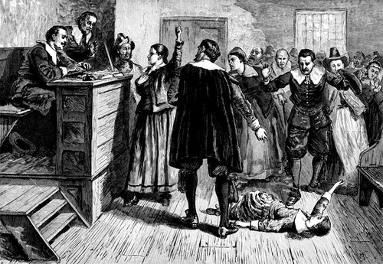
Setting
The time and place in which the events of a literary work occur
Includes the ideas, customs, and beliefs of a particular time and place
The setting of The Crucible is 1692 in Salem, Massachusetts.

Slide 7
Mood and Tone
Mood is the emotional quality of a literary work
Mood is created by language, subject matter, setting, tone, rhyme, and rhythm
Mood is a broader term than tone
Tone is the attitude of the author, speaker, or narrator toward the reader
Tone is conveyed through word choice, punctuation, sentence structure, and figures of speech

Slide 8
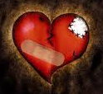
Theme
The central message of a work of literature, often expressed as a general statement about life
Themes are topics on steroids
Example:
Topic: Love
Theme: Love is painful

Slide 9
Point of View
The standpoint from which a story is told
First Person – the narrator is a character in the story and uses “I”, “we”, “me”, etc.
Second Person – the narrator is someone who stands outside the story and describes the characters and action; uses the pronouns “you” and “your”
Third Person Omniscient – the narrator is all-knowing; uses the pronouns “he”, “she”, “they”, etc.
Third Person Limited – the narrator describes events as only one character perceives them; uses the pronouns “he”, “she”, “they”, etc.

Slide 10
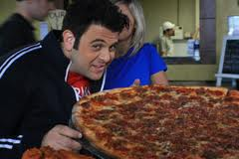
Conflict
3 types of conflict
Man vs. Man
Man vs. Nature
Man vs. Himself

Slide 11
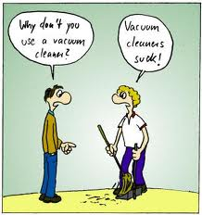
Pun - A play on words that have similar sounds but different meanings.
Examples:
Did you hear about the guy whose whole left side was cut off? He's all right now.

Slide 12
Irony - In literary criticism, the effect of language in which the intended meaning is the opposite of what is stated.
The title of Jonathan Swift's "A Modest Proposal" is ironic because what Swift proposes in this essay is cannibalism — hardly "modest."
A fish that drowns

Slide 13
Plot
The sequence of events in a short story, novel, or drama
Climax
Falling Action
Resolution
Rising Action
Exposition

Slide 14
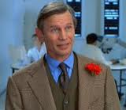
Exposition
Provides info on plot, background, setting, and characters
Ex. Basil Exposition from Austin Powers

Slide 15
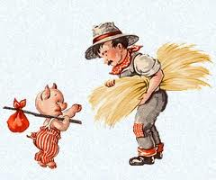
Rising Action
Introduces related secondary conflicts and various obstacles that keep the protagonist from reaching his/her/its goal

Slide 16
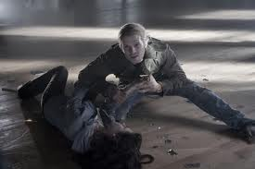
Climax
The point of greatest intensity or force
Dance studio scene in Twilight

Slide 17
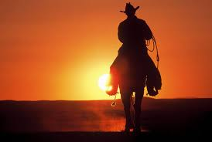
Falling Action and Resolution
The part of the story where the conflict unravels, and you are headed towards the conclusion

Slide 18
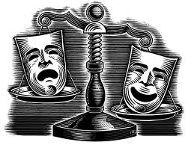
Drama
Works of literature meant to be performed on stage or read as a performance

Slide 19
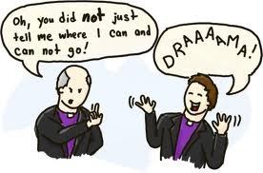
Dialogue
Conversation exchanged between characters

Slide 20
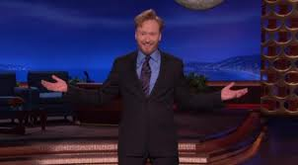
Monologue
A long speech in which a character speaks his/her thoughts aloud, addressing another character or the audience

Slide 21
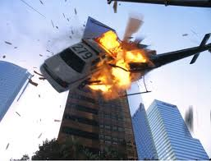
Action
In a play, action is always forward-moving

Slide 22
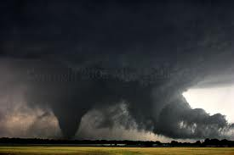
Dramatic Conventions
Ex. Dark lighting is scary; storms mean tension

Slide 23
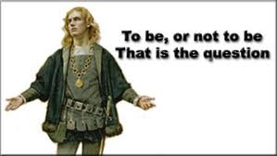
Soliloquy: a Dramatic Convention
A long speech addressed to no one in particular

Slide 24
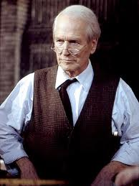
Narrative: a Dramatic Convention
Used to give exposition or background information; directed at the audience
Example
Paul Newman in Our Town

Slide 25
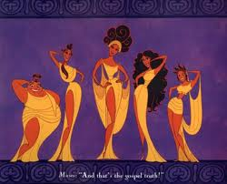
Chorus
Group of players who give key information about what’s happening

Slide 26
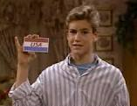
Aside
Private words that a character in a play speaks to the audience or to another character and that are not supposed to be overheard by others onstage.

Slide 27
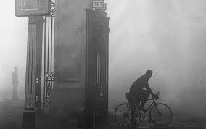
Atmosphere
The mood or feeling in a literary work
Usually created through descriptive details and language

Slide 28
Blank Verse
Poetry written in unrhymed iambic pentameter
“blank” = unrhymed
“iamb” = unstressed, stressed syllables
“penta” = five
“meter” = contains two syllables

Slide 29
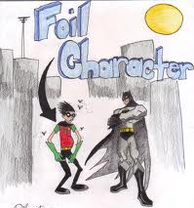
Foil
A character who sets off another character by strong contrast

Slide 30
Metonymy
A figure of speech in which something closely related to a thing or suggested by it is substituted for the thing itself
Examples:
The judge = the bench
The king = the crown
The president = the White House
“Washington is claiming popular support for its position.”

Slide 31
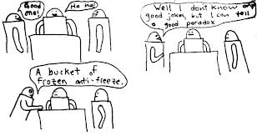
Paradox
An apparent contradiction that is actually true
“It was the best of times, it was the worst of times.” - Charles Dickens

Slide 32
Tragedy
A play, novel, or other narrative depicting serious and important events, in which the main character comes to an unhappy end

Slide 33
Tragic Hero
Wins some self-knowledge and wisdom, even though he or she suffers defeat, possibly even death

Slide 34
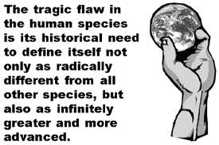
Tragic Flaw
Causes the character’s downfall
An error in judgment
A character weakness
Forces beyond his or her control

Slide 35
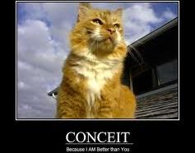
Conceit
A fanciful and elaborate figure of speech that makes a surprising connection between two seemingly dissimilar things
Hair of gold; lips of cherry red; teeth of pearl

Slide 36
Parallelism
The repetition of words, phrases, or sentences that have the same grammatical structure or that restate a similar idea
“He maketh me to lie down in green pastures:
He leadeth me beside the still waters.
He restoreth my soul:”

Slide 37
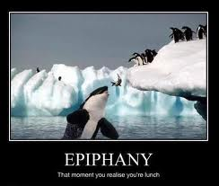
Epiphany
A moment of sudden insight or revelation that a character experiences

Slide 38
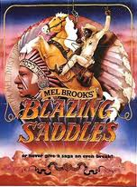
Parody - A parody is the imitation of a created work.
Airplane!
Blazing Saddles
Scary Movie

